Slide 1
SECURE DATA HIDING IN IMAGES USING STEGANOGRAPHY
CAPSTONE PROJECT
Presented By: Sakalabattula Reshma
Student Name : Sakalabattula Reshma
College Name & Department : Sri Sivani College of Engineering &Computer Science Engineering

Slide 2
OUTLINE
Problem Statement
Technology used
Wow factor
End users
Result
Conclusion
Git-hub Link
Future scope

Slide 3
Problem Statement
Sensitive information transmitted or stored digitally is vulnerable to interception, hacking, and misuse. To address this challenge, steganography offers a robust approach by concealing secret messages within images, making them imperceptible to unauthorized users. Effective method for securely hiding textual data inside images using pixel manipulation techniques. The secret message is embedded within the pixel values of an image and can only be retrieved using the correct passcode. The system ensures data confidentiality by integrating password-based access control, allowing only authorized users to decrypt and extract the hidden information.

Slide 4
Technology used
Libraries:
OpenCV (cv2): Used for image processing, including reading, modifying, and saving images.
OS: Provides system-level commands to open the encrypted image automatically.
String (optional): Can be used for character manipulation (though not explicitly used in the given code).
Platforms:
Operating System: Windows
Programming Language: Python
Development Environment: IDLE

Slide 5
Wow factors
* Simple yet Effective Steganography:
Unlike complex steganographic methods, this project provides a straightforward approach to hiding text within image pixels using basic pixel value modifications.
Password-Protected Decryption:
The hidden message can only be retrieved if the correct passcode is entered, adding an extra layer of security.
Lightweight and Fast Execution:
The algorithm does not rely on heavy cryptographic techniques, making it efficient and quick for embedding and extracting messages.
No Visible Change in Image Quality:
Since only minor pixel value modifications are made, the visual integrity of the image remains unchanged, making detection difficult.
Cross-Domain Application:
Can be used for secure communication, watermarking, digital forensics, and copyright protection.

Slide 6
End users
Cybersecurity Enthusiasts & Researchers
Individuals studying data security and cryptography can use this project to understand steganography techniques.
Government & Intelligence Agencies
Used for confidential communication and secure data transmission without raising suspicion.
Journalists & Whistleblowers
Enables secure exchange of sensitive information without detection.
Corporate Organizations
Companies can protect trade secrets and confidential data from unauthorized access.
Forensic Experts
Helps in digital forensics for secure watermarking and tracing digital evidence.
Individuals Concerned About Privacy
Regular users who wish to communicate sensitive data securely without traditional encryption.
Software Developers & Ethical Hackers
Can use it as a foundation to develop more advanced steganography tools for ethical hacking and cybersecurity applications.

Slide 7
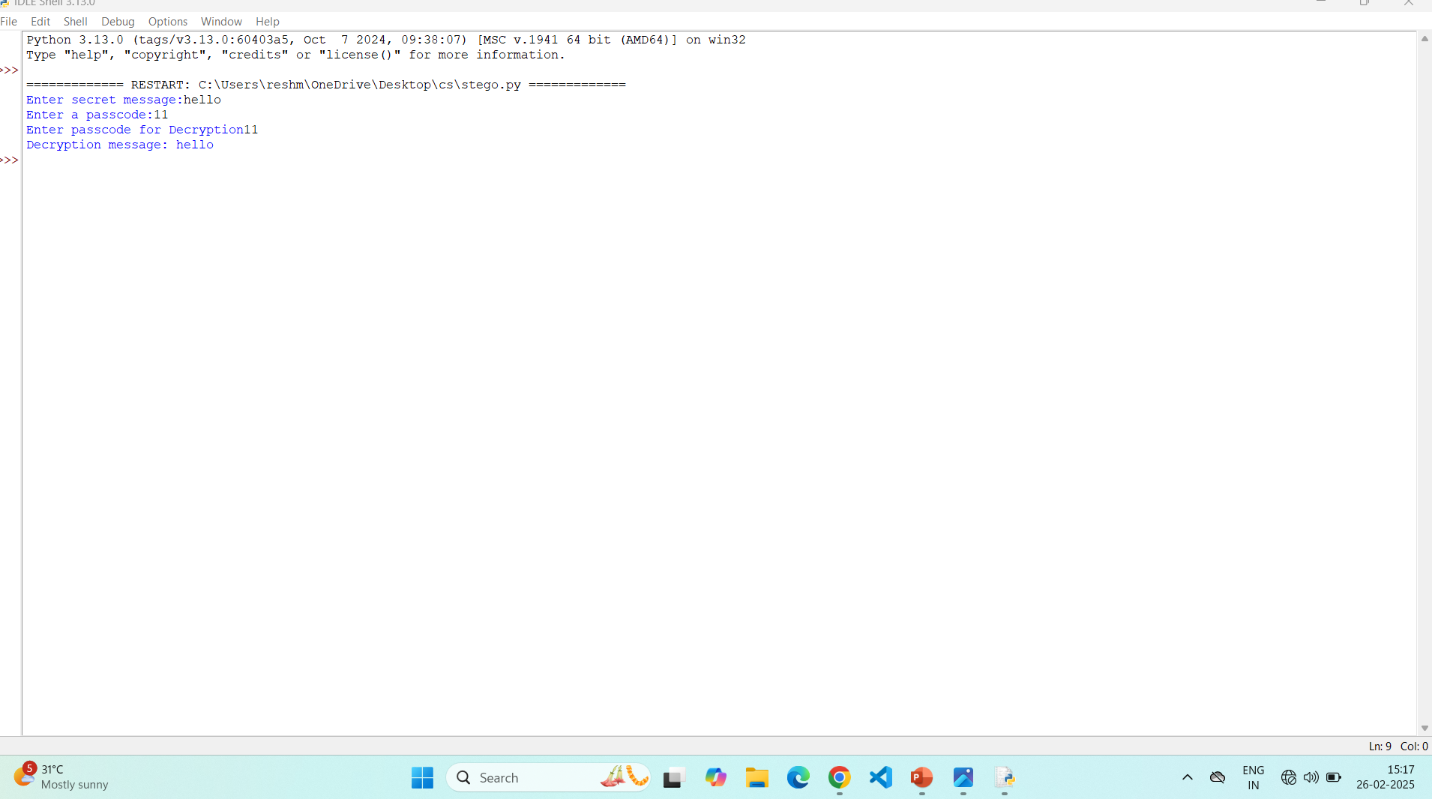
Results

Slide 8
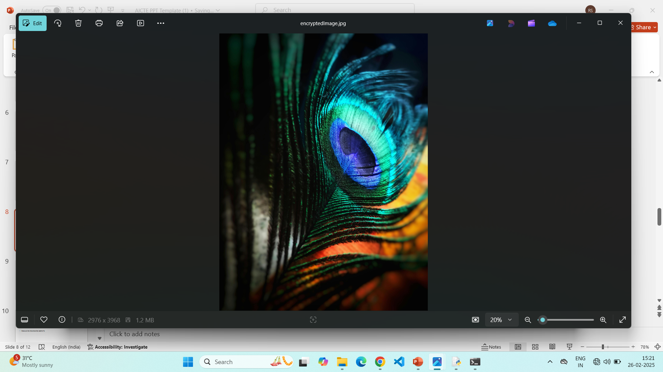
Results

Slide 9
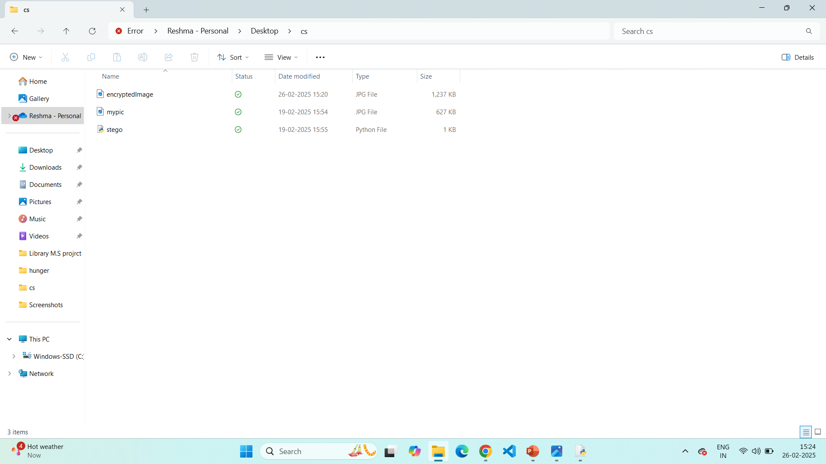
Results

Slide 10
Conclusion
In today's digital age, where data security is a major concern, steganography provides an effective solution for covert communication. This project successfully implements a simple yet powerful method for secure data hiding in images using pixel manipulation techniques. By embedding a password-protected secret message within an image, the system ensures that only authorized users can access the hidden information, enhancing confidentiality and security.
With minimal impact on image quality, fast execution, and offline functionality, this approach stands out as a lightweight yet effective steganographic technique. The project can be applied in various domains, including cybersecurity, intelligence communication, digital forensics, and personal data protection.
Overall, this steganography-based system demonstrates a practical and secure way of transmitting sensitive information without attracting unwanted attention.

Slide 11
GitHub Link
https://github.com/Reshma2004-eng/csproject.git

Slide 12
Future scope(optional)
Enhanced Security with Encryption:
Integrate cryptographic encryption (e.g., AES, RSA) before embedding the message to add another layer of protection.

Slide 13
THANK YOU

